Slide 1

Point Switch Functionality Detection in Railroads
Dharanidharan K (910022104037)
Santhosh Kumar R (910022114002)
Vignesh K (910022106042)
Mentor: Dr. A. Muthumari (SL/AP)
Anna University Regional Campus Madurai

Slide 2



Introduction
The Problem: Urgent Need
Frequent derailments caused by improper switch alignment pose significant risks. There's a critical lack of real-time monitoring for train pilots, compromising safety. Eg: BALASHORE INCIDENT
Railway Safety
Our Solution: Scope of Work
Railway safety is paramount, and point switches are critical components in guiding trains safely between tracks.
We aim to develop a low-cost, real-time detection system for point switches. This system will utilize LoRa for wireless communication to alert locomotive pilots. Our future vision includes integration with broader automation and IoT systems.

Slide 3
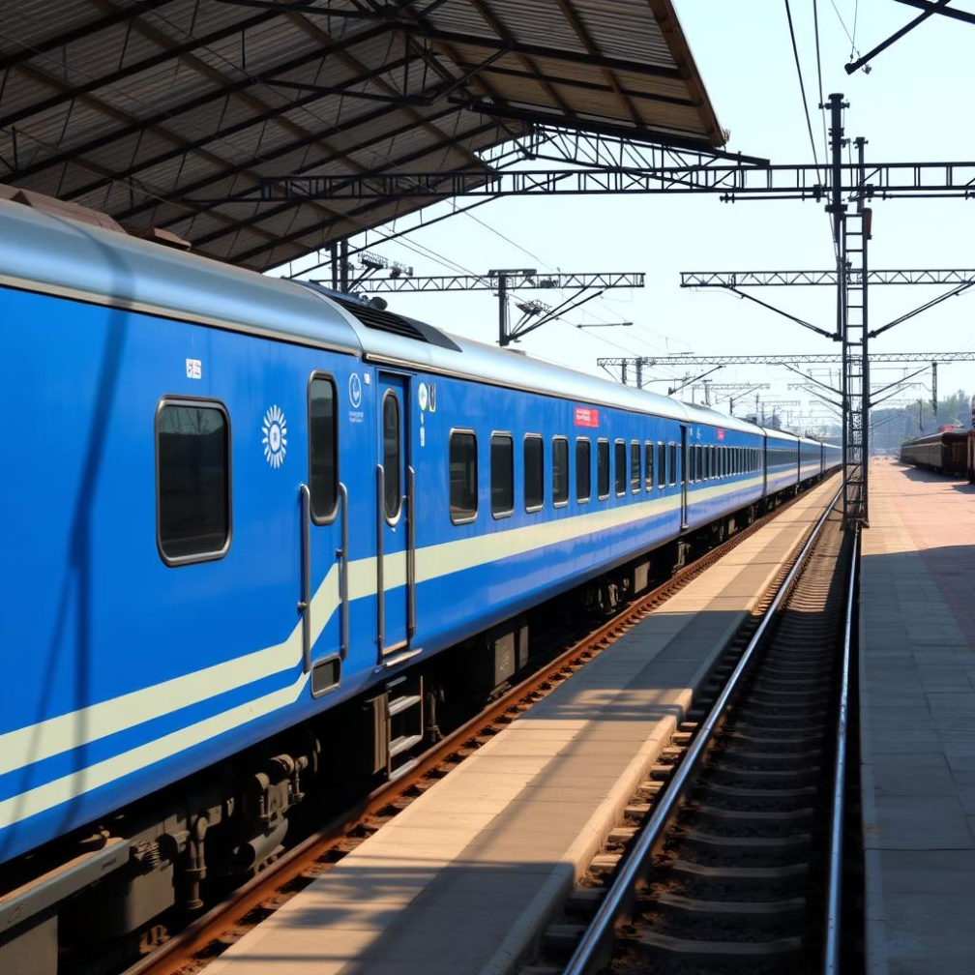





Objectives & Methodology
Implementation Methodology
Servo Motor: Utilized for precise control and movement of the switch mechanism.
Inductive Proximity Sensors: Employed to accurately detect the alignment status of the rail tracks.
LoRa Transmitter-Receiver: Enables reliable wireless communication over distances of approximately 1 km for data transmission.
Buzzer Alert: Provides immediate audible warning in the pilot's cabin upon detecting misalignment.
Our Core Objectives
Our project aims to:
Detect accurate or inaccurate alignment of railroad point switches in real-time.
Prototype Testing: Rigorous testing of the developed system to ensure functionality and reliability.
Provide immediate wireless alerts directly to train pilots in their cabins.
Significantly reduce the incidence of train derailments, thereby enhancing overall railway safety.

Slide 4
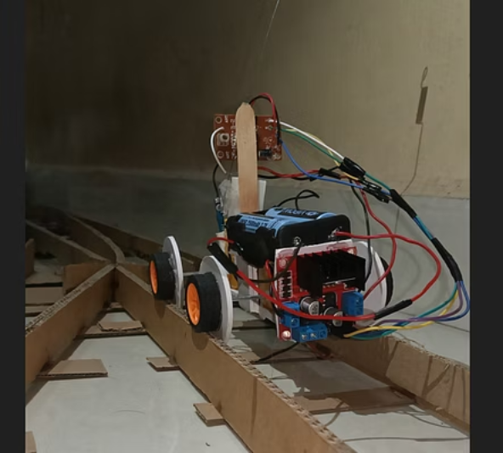
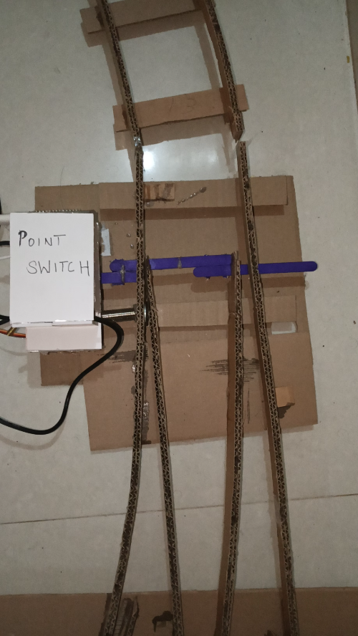
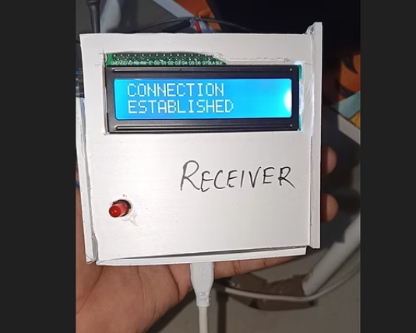
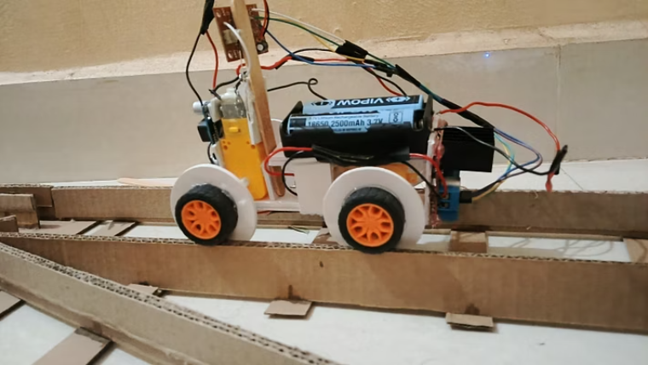
Results & Discussion
Key Results & Achievements
Acknowledged Limitations
Successful real-time detection of track alignment.
The current system is a prototype, operating at a limited scale.
Wireless transmission functionality tested within a 1 km range.
Further development required for comprehensive weatherproofing.
Immediate pilot notification via LCD, Buzzer, and LED indicators.
Challenges associated with large-scale deployment need to be addressed.
Significantly reduced response time compared to manual detection methods.

Slide 5

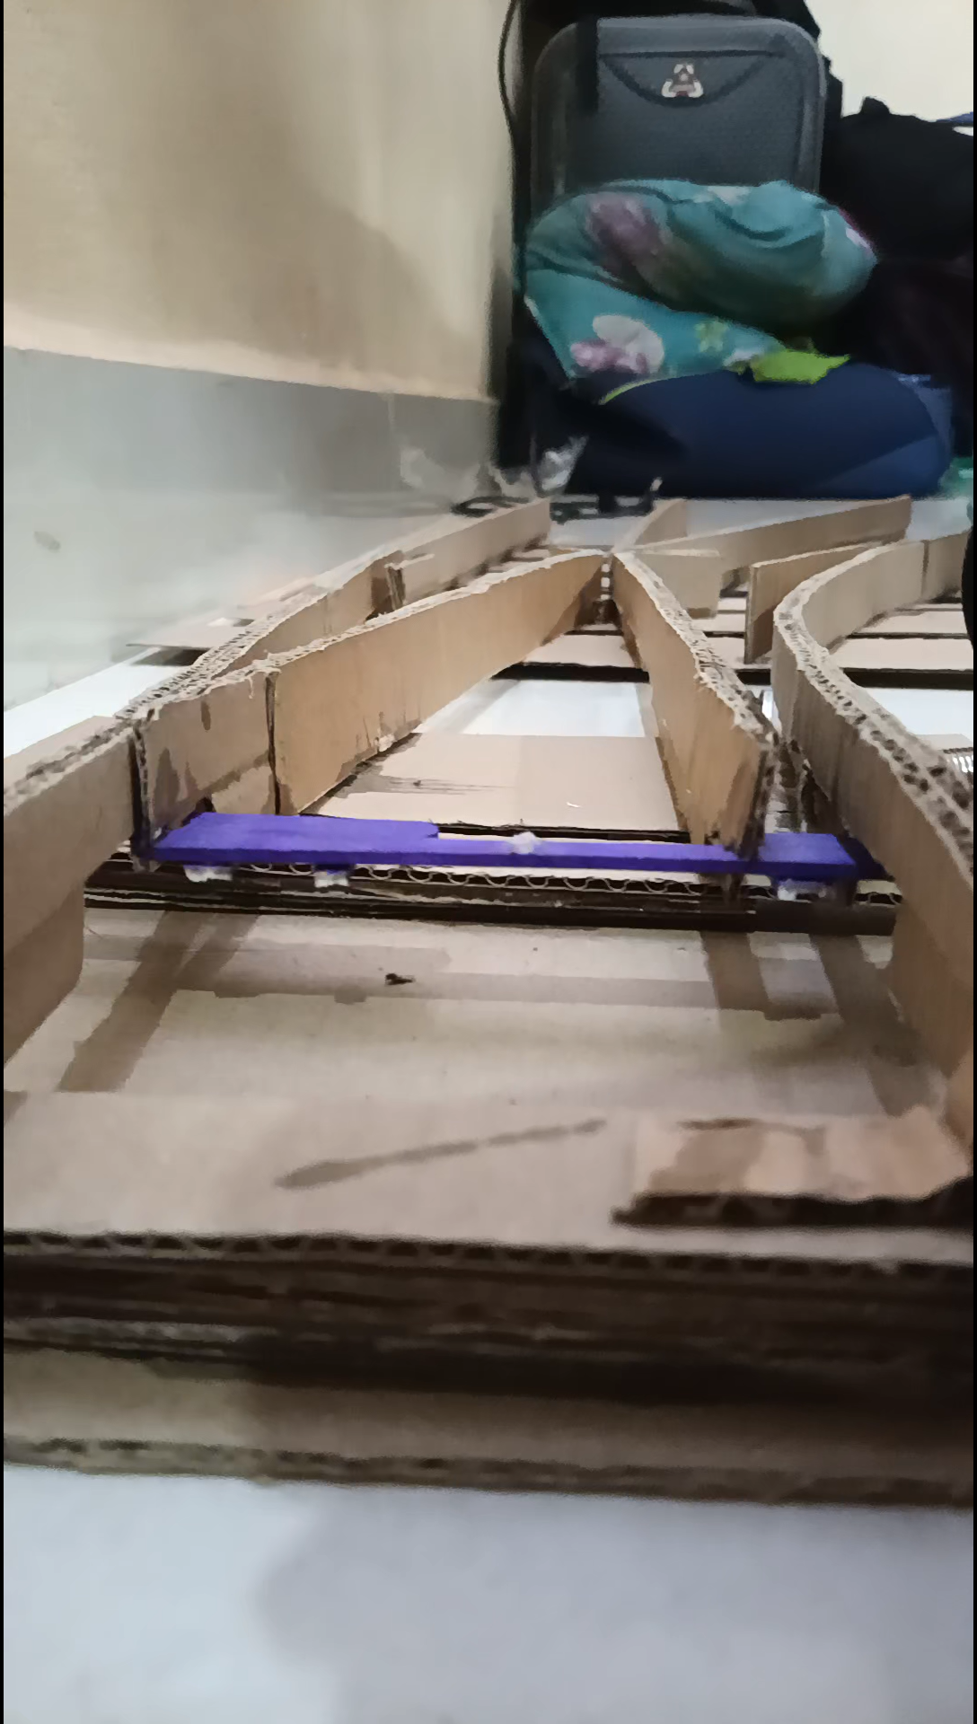
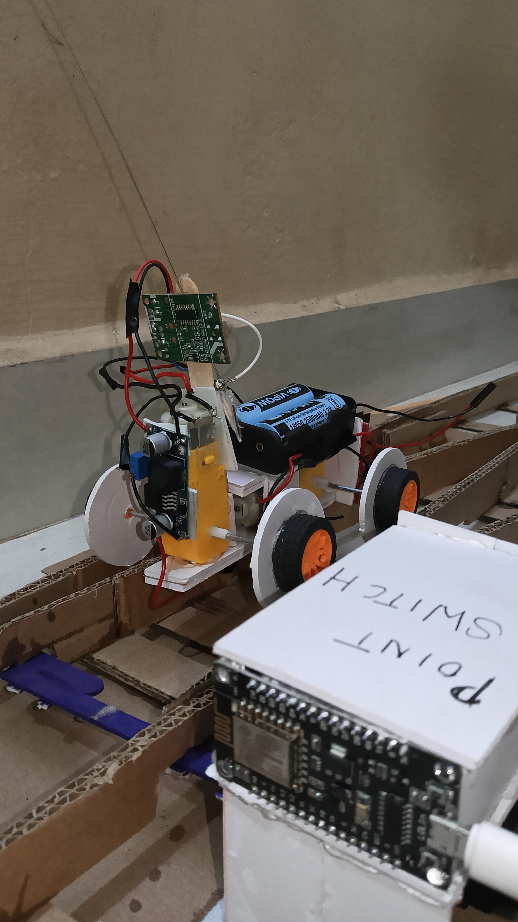
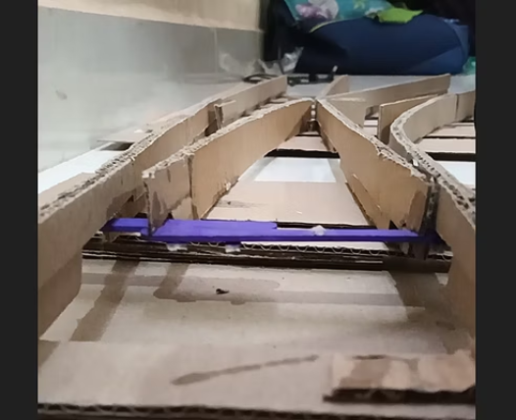
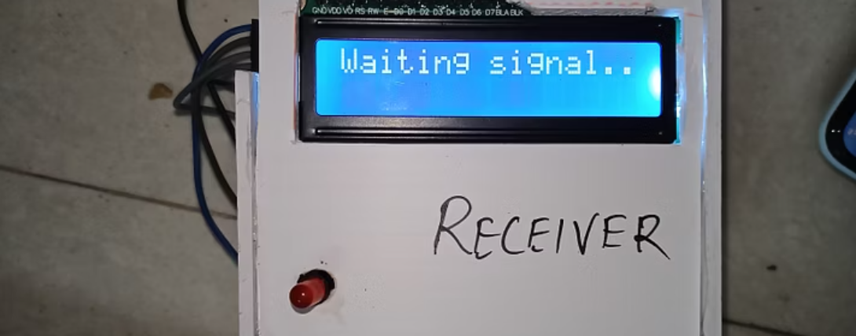
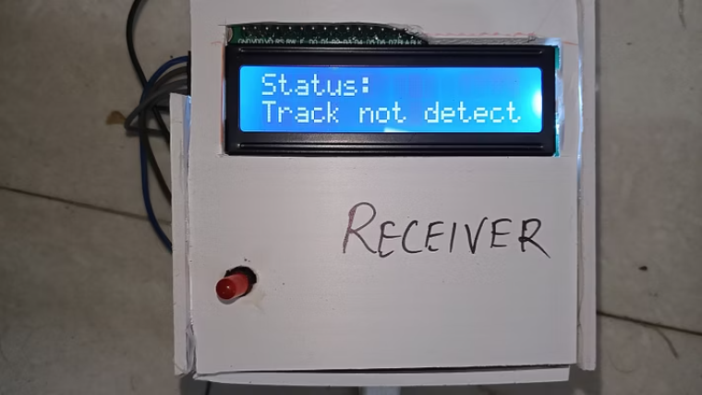
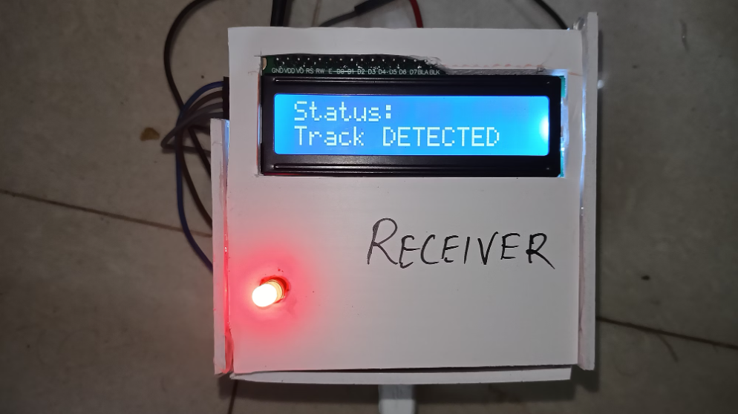
Results & Discussion

Slide 6







Prototype / Process Developed
Prototype Features
Motorized Point Switch Model
Inductive Proximity Sensors
A miniature model of a point switch controlled by a servo motor, enabling precise operation and simulation of real-world rail movements.
Sensors positioned at the switch junction to accurately detect the physical alignment or misalignment of the rail tracks.
LoRa Wireless Module
Cabin Alert System
An integrated LoRa module facilitating long-range, low-power wireless communication for data transmission.
An alert system comprising an LCD display for text messages, LED indicators for visual cues, and a buzzer for audible warnings within the pilot's cabin.
Process Flow
Train Approaches
Sensor Checks & Data Transmission
Pilot Receives Alert
As the train approaches the point switch (within approximately 1 km range), the system activates.
The inductive proximity sensors check the alignment of the point switch, and the data is wirelessly transmitted via the LoRa module.
The locomotive pilot immediately receives an alert in their cabin, indicating either 'Track Detected' (aligned) or 'Track Not Detected' (misaligned).

Slide 7
Conferences / Publications
IEEE Conference on Intelligent Transportation Systems.
Naan Mudhalvan 4.0 Hackathon Winner.

Slide 8
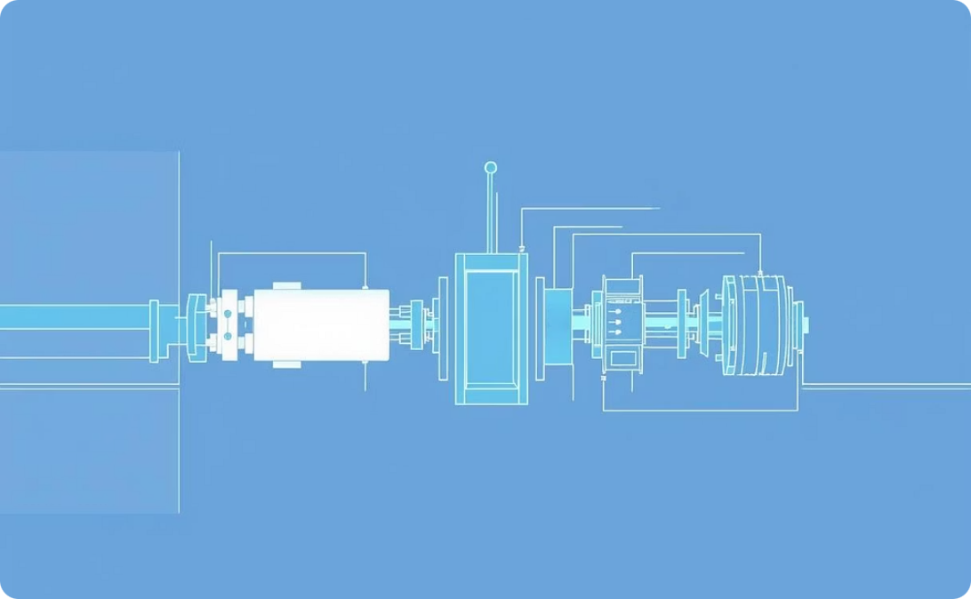


Outcomes / Conclusion
Outcomes
Conclusion
Future Scope
Our project successfully developed a functional prototype that provides real-time wireless alerts for railway point switch alignment, enhancing immediate operational awareness.
The system has the potential to significantly reduce derailments, leading to improved railway safety. It is designed for scalability, allowing for future integration with broader IoT and AI systems for enhanced capabilities.
Future development includes integrating camera modules for visual verification, implementing cloud-based monitoring for centralized data access, and incorporating AI for predictive maintenance to anticipate issues before they occur.

